Slide 1



CFDE SHORT COURSE: Human Microbiome Data Discovery 2026
Fusobacterium nucleatum interspecies metabolites exchange in oral biofilm
<Group Two> Presentation
Presenters: Sheetal Akula, Hua Zhang, Zhengzhong Zou, Jia Hui Isabelle Jang.
Sunday, 9/20/2026
Notes:
Please update this for your title slide

Slide 2
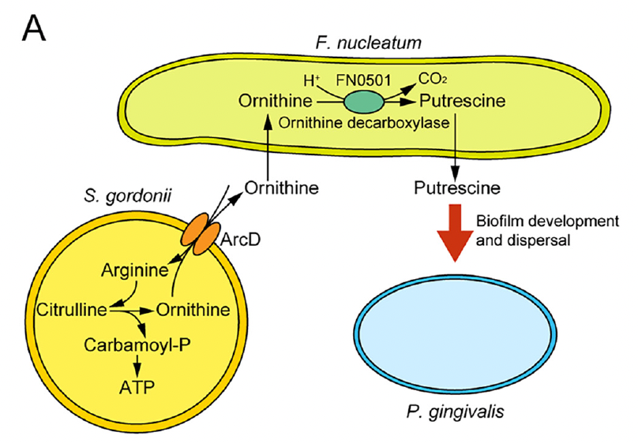
BACKGROUND/IMPORTANCE
An inflammatory environment related to periodontitis is associated with development of oral cancers.
Fusobacterium nucleatum is a common and important constituent of oral microbiome and polymicrobial oral biofilms.
Metabolic integration within polymicrobial communities and the impact on periodontal pathogenesis are poorly understood.
Figure. Metabolic cross-feeding between oral bacteria can support community growth and pathogen colonization.
Notes:
Other notes:
•Oral biofilms are multispecies communities where metabolic “cross-feeding” between species can enable pathogen colonization; Fusobacterium nucleatum (Fn) is proposed as a metabolic bridge linking early colonizers to later pathogens.

Slide 3

AIM/GOAL
To compare the extracellular metabolite profiles of F. nucleatum alone compared with F. nucleatum cocultured with S. gordonii and/or V. parvula.
Notes:
To dissect the extracellular metabolic interactions mediated by F. nucleatum cocultured with S. gordonii and/or Veillonella parvula

Slide 4

CFDE DATA RESOURCES
CFDE Resources Used:
Metabolomics workbench
Accessed through journal website which referenced metabolomics workbench (https://journals.asm.org/doi/10.1128/msystems.00170-22#dataS1)
Search Process:
CFDE Cloud
iPOP HMP website
Metabolomics workbench
Notes:
What CFDE resources did you use? Why did you select this resource? Did you use any other external datasets?
CFDE Cloud:
Unable to access data for a potential project (EsophAdeno)/oral microbiome cancer related projects
iPOP HMP website:
No cancer related data

Slide 5
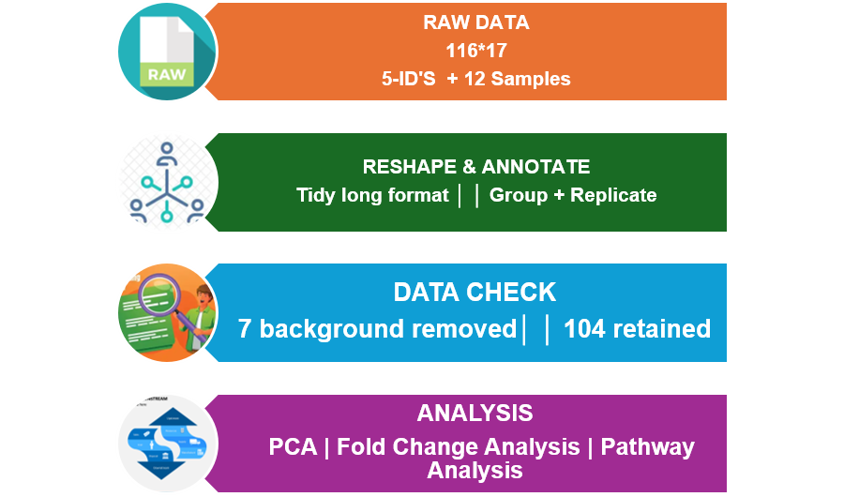
APPROACH
Notes:
What formatting approaches did you use to prepare the data for processing?
Parsed the single-sheet workbook
(116 rows × 17 columns): 5 identifier columns (Metabolite,KEGG_ID, HMDB_ID, m/z, RT) plus 12 sample columns (4 conditions × 3 replicates). Reshaped to tidy long format, deriving Group (culture condition) and Replicate from each sample name by regex.
• Removed 7 metabolites flagged in the source spreadsheet (via cell shading) as sterile-medium
background rather than bacterial output, leaving 104 of 111 metabolites for analysis.
• Used a half-minimum pseudocount for all log2 transforms (PCA, heatmap, fold-change) —
appropriate here because non-detects in this dataset are true zeros, not left-censored values

Slide 6
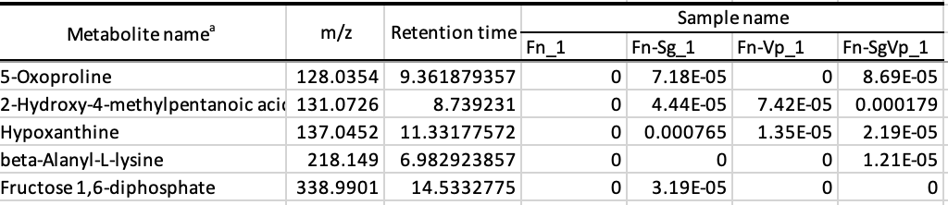
EXPECTATIONS
The data met our expectations.
Well organized
Labels are clear:
  Sample name
  Metabolite name
  m/z ratio
  Retention time
  KEGG and HMDB identifiers were available for metabolite annotation
Limitation: Only the curated metabolite table was publicly available; raw spectral files and extended QC metrics were not provided
Notes:
Did the data meet your expectations?

Slide 7
LESSONS
What was learned from this process?
Understand the data before transformation
True zeros ≠ censored/BLOQ values
Preprocessing affects results
Zero handling impacts log₂ transformation and fold-change
Always visually validate outputs
Coding errors can silently produce incorrect results, such as an all-NA heatmap
More about Principal component analysis

Slide 8
ANALYSIS
Analysis | Why
Exploratory Analysis | Compare metabolite detection across cultures
Principal Component Analysis | Explore overall metabolome patterns and clustering
Log2-Fold Change | Qualify changes in metabolites differing across co-cultures
Pathway Analysis | Compare metabolites specific to certain pathways
Notes:
What types of analyses were you able to perform? Why did you choose these analyses? What analyses were you expecting to do?
The Kruskal-Wallis test is a non-parametric statistical test used to determine if there are statistically significant differences between three or more independent groups on a continuous or ordinal dependent variable.

Slide 9
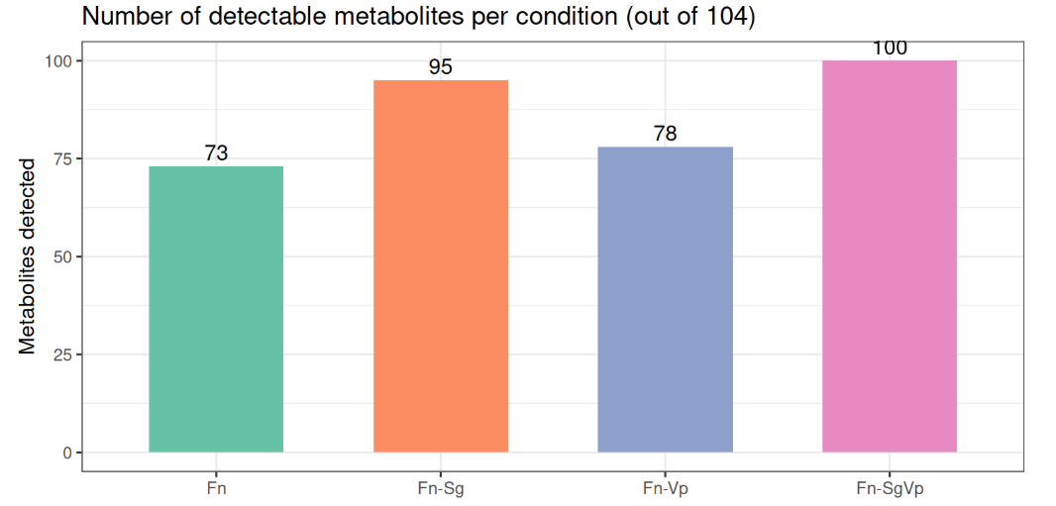
RESULTS
Figure. Number of metabolites detected in each culture.
Total 104 unique metabolites detected in the study.

Slide 10
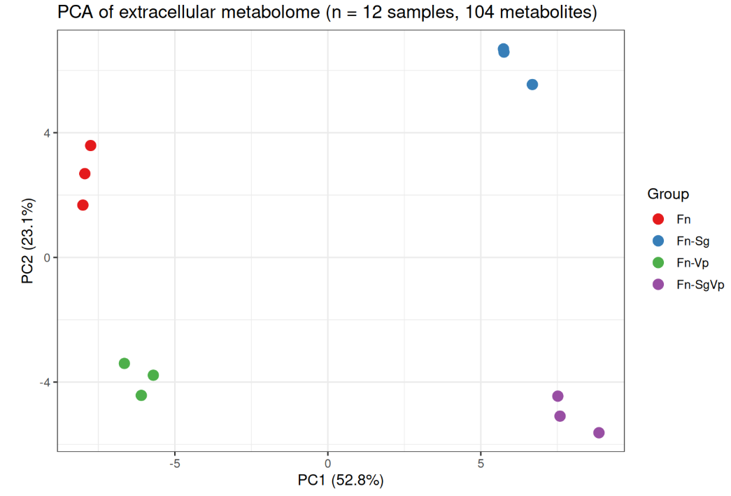
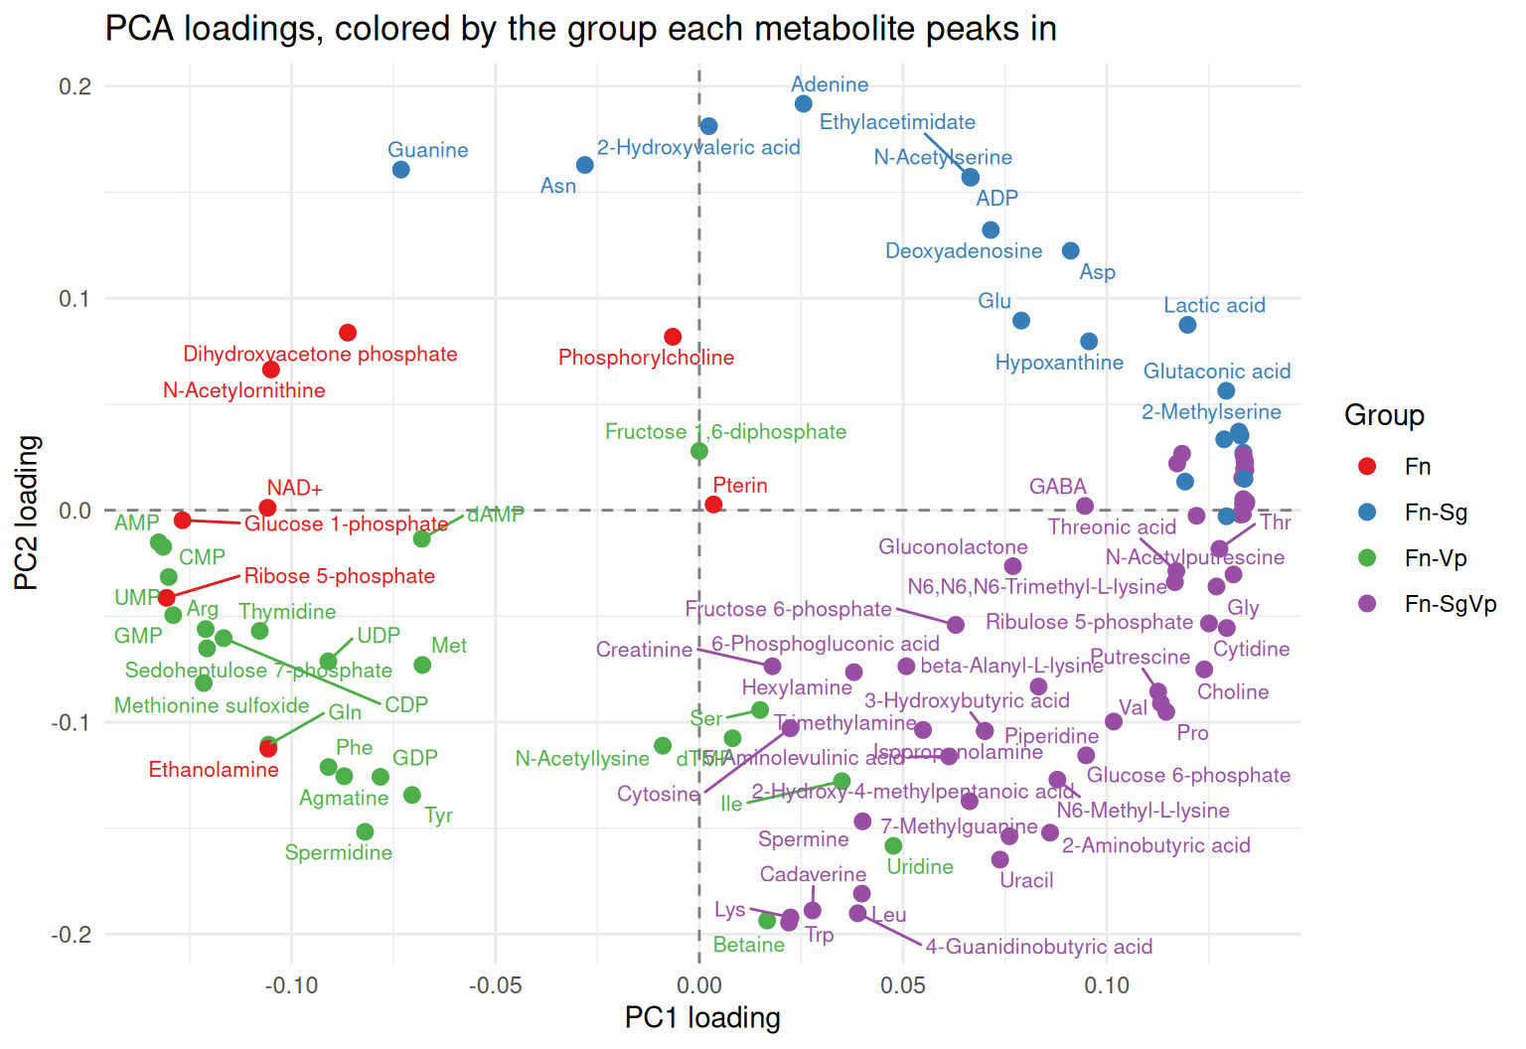
RESULTS
Figure. PCA plot of samples from the different cultures/co-cultures showing 4 distinct clusters
Figure. Plot of PC2 vs PC1 showing metabolites associated with different quadrants

Slide 11
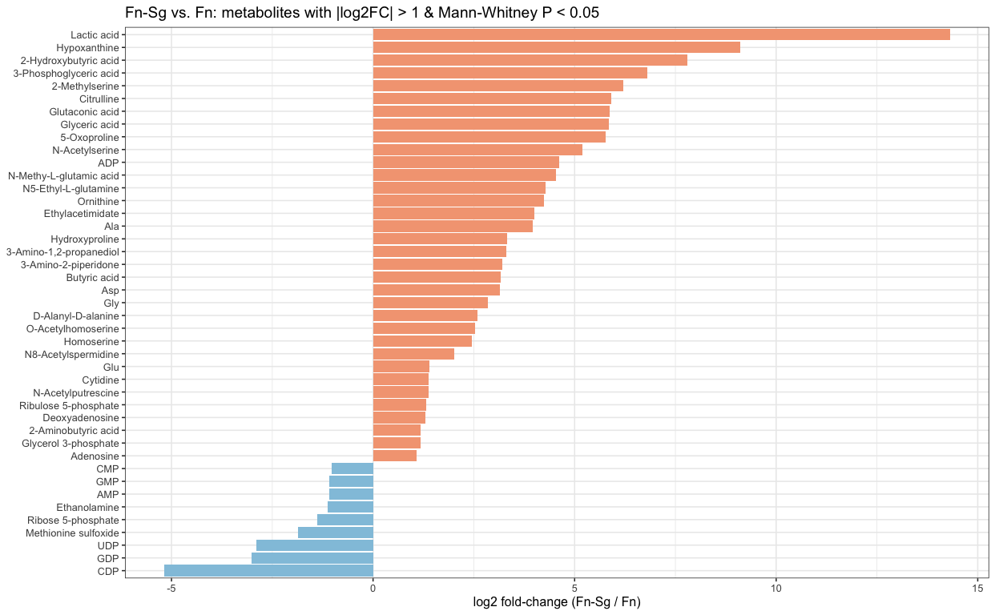
RESULTS
Figure. Log2fold change plot of metabolites change showing significant changes in F. nucleatum with S. gondii vs F. nucleatum alone

Slide 12
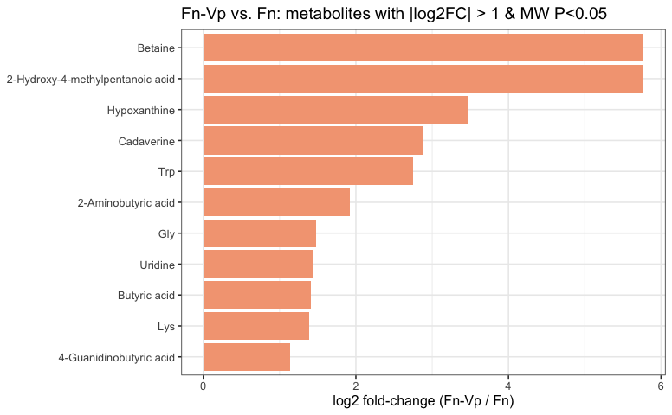
RESULTS
Figure. Log2fold change plot of metabolites change showing significant changes in F. nucleatum with V. parvula vs F. nucleatum alone

Slide 13
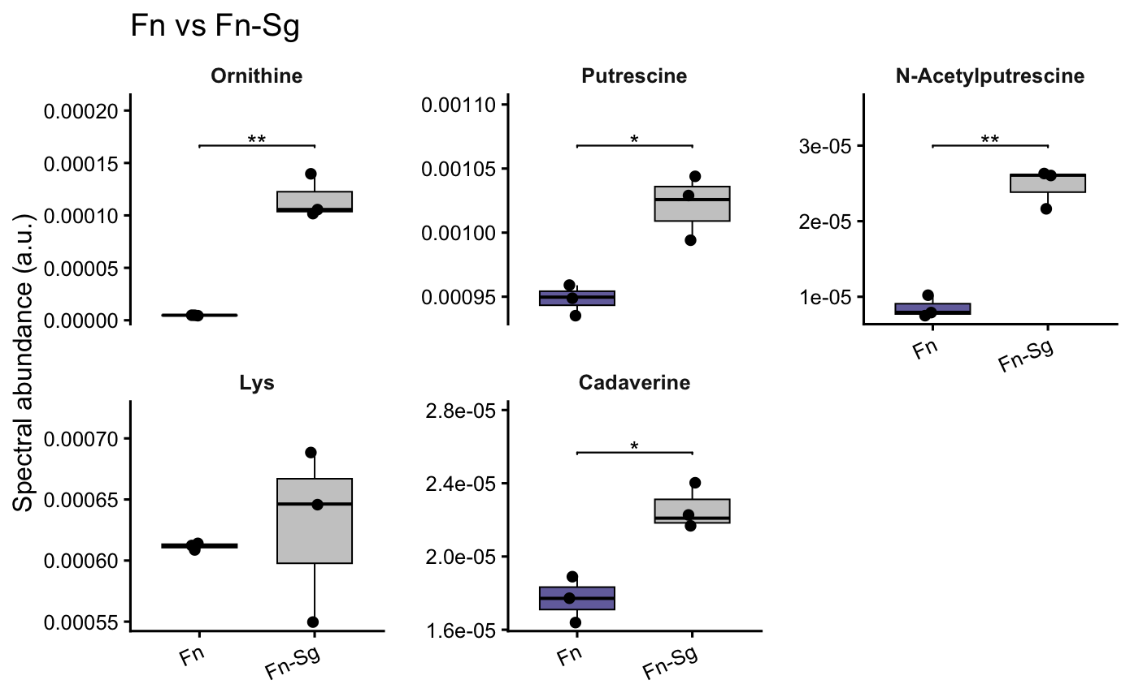
RESULTS
Figure.Levels of metabolites spent in Fn-Sg coculture and Fn monoculture showing that ornithine, putrescine and downstread N-acetylputrescine is elevated when SG is present (as expected)
Notes:
Some metabolites are related to certain pathways, and the metabolites are related to the pathway change.
This is the direct test of the hypothesis. If *S. gordonii* releases ornithine that Fn converts to putrescine, **Ornithine and Putrescine (and downstream N-Acetylputrescine) should be elevated specifically when Sg is present** (Fn-Sg and Fn-SgVp), not when only Vp is present. Symmetrically, **Lysine and Cadaverine should be elevated specifically when Vp is present** (Fn-Vp and Fn-SgVp).

Slide 14
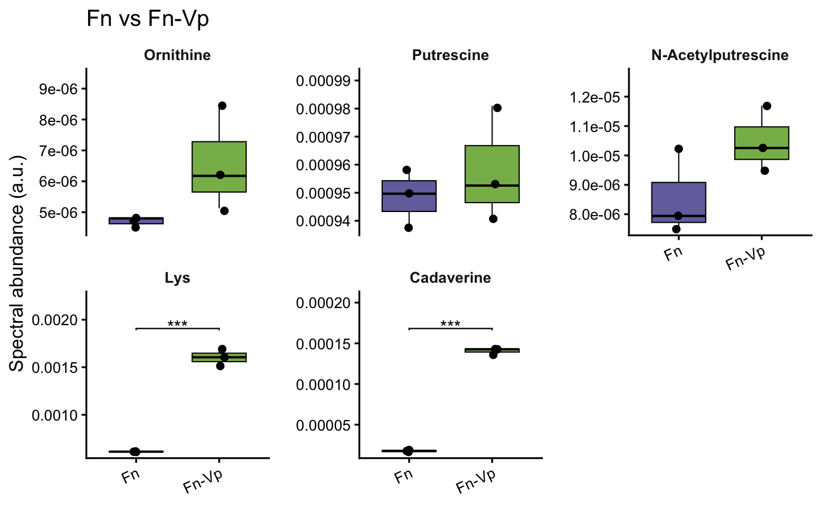
RESULTS
Figure.Levels of metabolites spent in Fn-Vp coculture and Fn monoculture showing that lysine and cadaverine is elevated; and ornithine, putrescine, N-acetylputresciene is not elevated when Vp is present (as expected).
Notes:
Some metabolites are related to certain pathways, and the metabolites are related to the pathway change.
This is the direct test of the hypothesis. If *S. gordonii* releases ornithine that Fn converts to putrescine, **Ornithine and Putrescine (and downstream N-Acetylputrescine) should be elevated specifically when Sg is present** (Fn-Sg and Fn-SgVp), not when only Vp is present. Symmetrically, **Lysine and Cadaverine should be elevated specifically when Vp is present** (Fn-Vp and Fn-SgVp).

Slide 15
LIMITATIONS
Small Sample Size
n = 3 replicates/condition
Require non-parametric testing
Study used Transwell Model
Measures only diffusible, contact-independent metabolites
Does not capture cell-contact interactions or full multispecies biofilm dynamics
Focus on extracellular metabolites due to limited time
Notes:
What limitations did you experience?

Slide 16
FUTURE DIRECTION
If you had more time, which additional analyses would you perform?
Download data from other studies to reproduce
What additional questions did the analysis support?
Study of Fusobacterium Nucleatum with other co-cultures in vivo model (e.g. animal model)

Slide 17

Generated by google gemini

